Slide 1




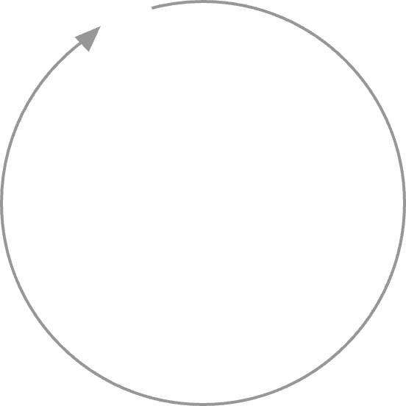




Title of project
Review & Reflect
Interests & Aims
Focus & Question
ADD YOUR OWN INSTITUTIONAL LOGO
Action Plan
Plans & Methods
Interpretation
Data Engagement
Name & institutional affiliation
Template adapted from ED:Talk (Evidence and Dialogue) Toolkit
With thanks to Riikka Hofmann & Sonia llie. ©2019
Faculty of Education, University of Cambridge

Slide 2
Inquiry setting
Provide a brief description of the following features of your inquiry
Inquiry Setting:
Subject(s) / Area:
Topic:

Slide 3







Inquiry cycle
Identifying points of interest
and possible goals (click here to edit this box)
Considering how the whole
process has worked (click here to edit this box)
Narrowing down focus and inquiry questions (click here to edit this box)
Developing practice
based on the findings (click here to edit this box)
Planning the inquiry and
choosing methods and tools (click here to edit this box)
Considering the findings and reflecting on what they might mean (click here to edit this box)
Conducting the inquiry
and gathering evidence (click here to edit this box)
Notes:
When you talk through the cycle, include info about:
The challenge in your setting that you wanted to address
The project’s goal
Activities, steps taken and resources used
Timeline
Ethical issues
What you evaluated and How - including tools / measures / data

Slide 4
The experience of running the inquiry
How the project actually unfolded:
What worked well:
Challenges:

Slide 5
Results / findings
To what extent were the goals met/ not met?
How?
What were the key mechanisms of change?

Slide 6
Resource
for dialogic teaching and learning
[A brief description of the teaching/classroom resource you created]
Notes:
Move this earlier if appropriate

Slide 7
Reflections
[Choose one or two of the topics below to focus on]
  What I learned:
  My biggest insight:
  The project’s biggest impact:
  The biggest disappointment:
  The biggest surprise:
  The biggest support in carrying out the project / conditions for success:
  What I would do differently next time:
  My advice to a colleague trying this out:
Notes:
[Choose one or a maximum of two of below to focus on]
What I learned:
My biggest insight:
The project’s biggest impact:
The biggest disappointment:
The biggest surprise:
The biggest support in carrying out the project / conditions for success:
What I would do differently next time:
My advice to a colleague trying this out:

Slide 8
Next steps
What I’m going to do next:
How I’m going to carry on:

Slide 9
Reflective inquiry cycle
Interests & Aims
Review & Reflect
Focus & Question
Plans & Methods
Action Plan
Data Engagement
Interpretation
Notes:
For your information

