Slide 1
BNU-Cambridge Schools-Camtree Internship Project
BNU Internship Project
29 June 2025
Orientation
Dr. Patrick Carmichael
Camtree: The Cambridge Teacher Research Exchange
Hughes Hall, University of Cambridge

Slide 2
Cambridge, Hughes Hall and Camtree

Slide 3
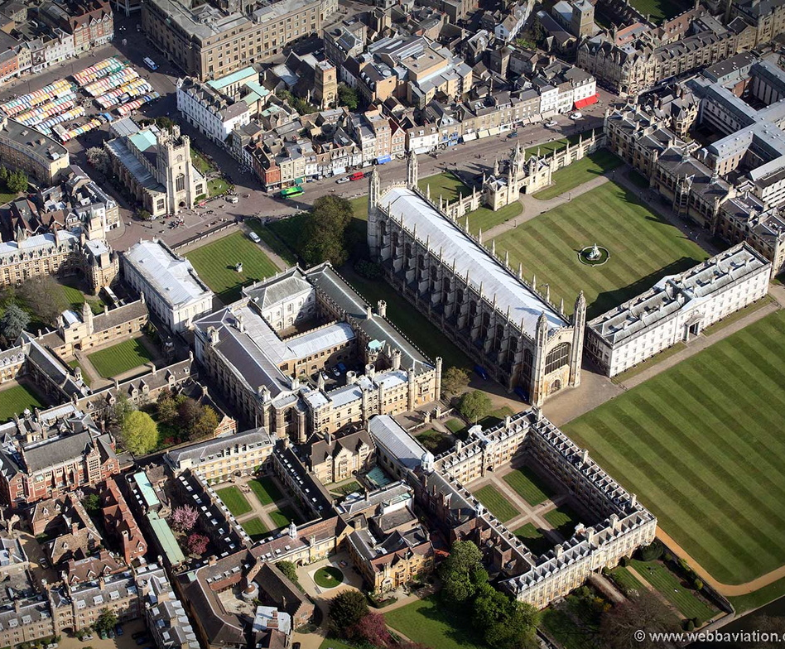
Welcome to Cambridge University
Founded in 1209 by Scholars escaping from Oxford!
About 25000 students (11000 postgraduates)
There are 31 Colleges, six Schools and over 150 Faculties and Departments that make up the University of Cambridge.
The colleges were set up as ‘fellowships of scholars’ and students are members of a college, though they may do most of their work in a department.
7 Museums, a Botanical Garden, and 116 Libraries

Slide 4
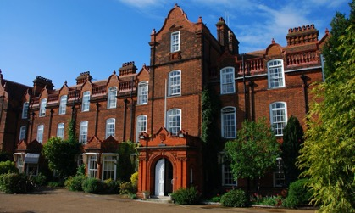

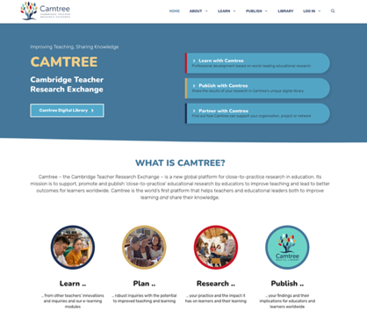
Camtree: The Cambridge Teacher Research Exchange
Camtree is based at Hughes Hall.
Hughes Hall is one of the 31 colleges, founded 140 years ago, for women students attending the university.
Camtree supports, promotes and publishes teacher research, and has partners around the world.
Camtree sees teachers as producers of knowledge, and teacher research as central to educational improvement.
Camtree is addressing a common problem – that teacher knowledge is usually not shared effectively in ways that other teacher can learn from it, act on it, and take it further.

Slide 5
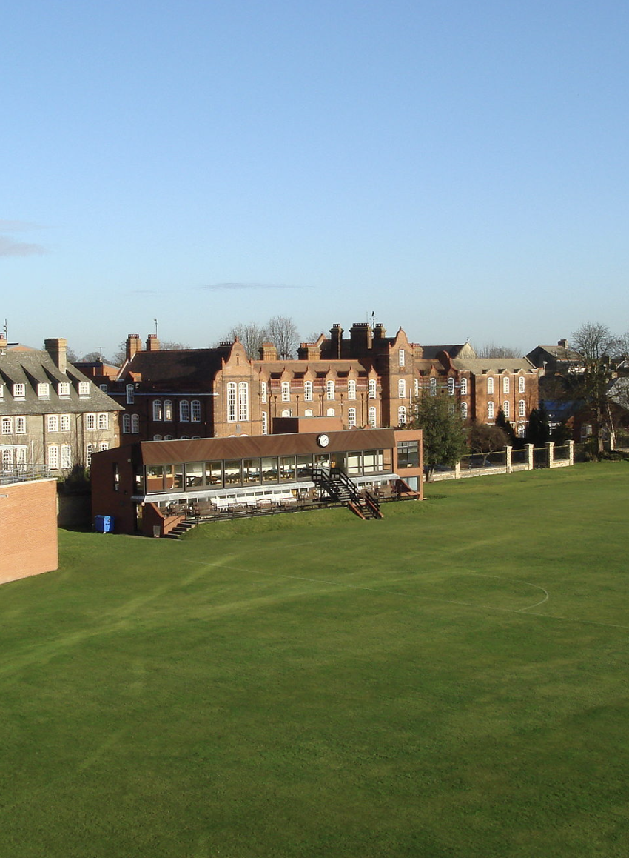
If you come and visit us …
Arrive in Cambridge
A first visit to your school
3.5 days at Hughes Hall
  About the UK Education System
  Exploring Classroom Talk
  Participatory Research Approaches
Identifying a Research Focus
Planning a Research Inquiry
And a final review before you go into school to share your ideas …
We’ll have a final review event too.

Slide 6
Schools in the UK

Slide 7
UK Schools: Some Background
Primary School
Secondary School
Early Years
(0-5)
Key Stage 1
(5-7)
Key Stage 2
(7-11)
Key Stage 3
(11-14)
Key Stage 4
(14-16)
School ‘Sixth Form’
College
Vocational Education
The UK Education System is very diverse!
England, Scotland, Wales, Northern Ireland - all have their own education systems.
There is an Early Years Framework and a National Curriculum for Key Stages 1-4, but schools can deliver this in many ways and there are no set textbooks.
There are many different kinds of schools and local variations – education is a ‘free market’ regulated by central government.
Teacher Education is also diverse – university based training is not the only way to become a qualified teacher. Increasing ’school-based’ training for graduates.
20% of children have a first language other than English – higher in cities. 24% receive free school meals because of low family income.
7% in independent (fee-paying) schools.

Slide 8
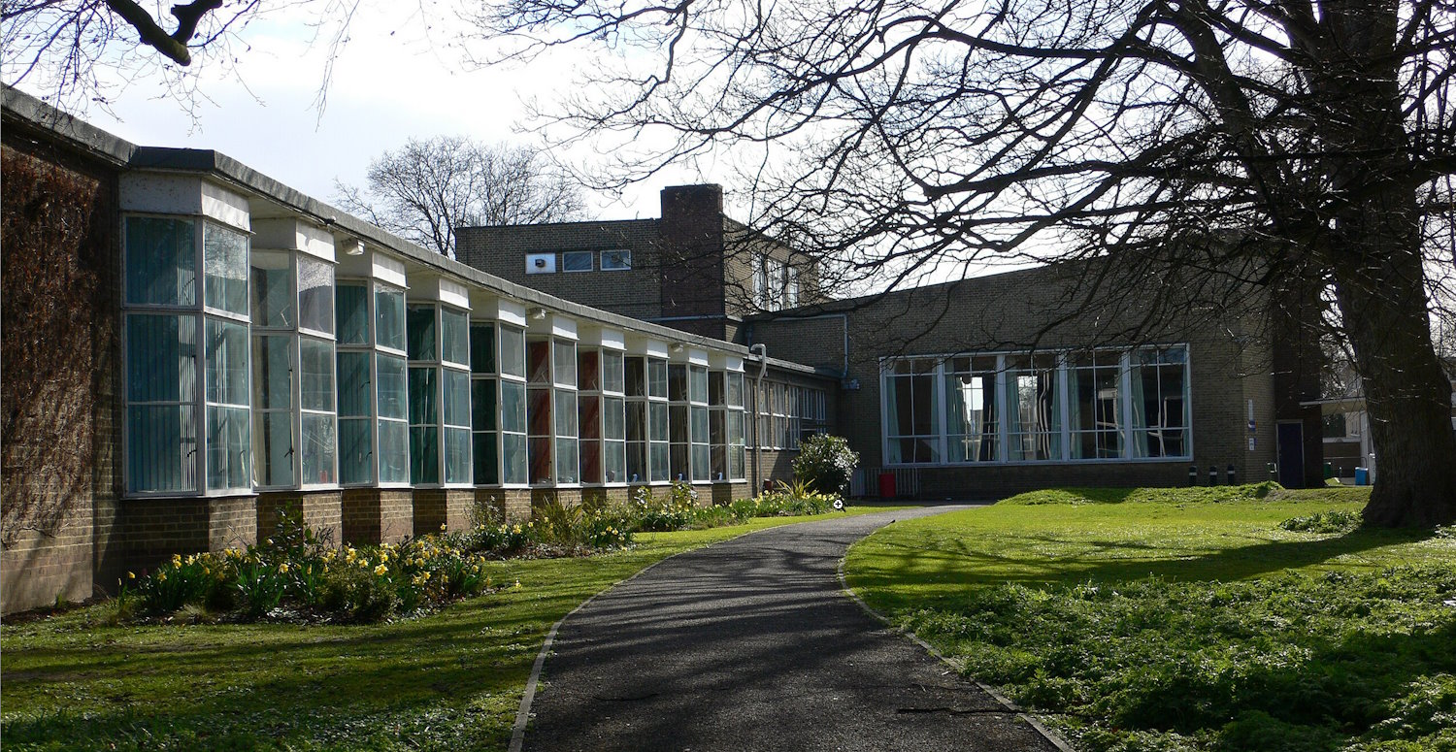
The Village Colleges
A local initiative in Cambridgeshire.
Villages outside Cambridge had poor education and other public facilities.
Henry Morris, Secretary of Education for Cambridgeshire proposed in 1924 the idea of ‘Village Colleges’: providing schooling, early years care, adult education, libraries and health services.
Built from 1930 (Sawston) to 1964 (Witchford)
Impington Village College 1939: Walter Gropius, Architect

Slide 9
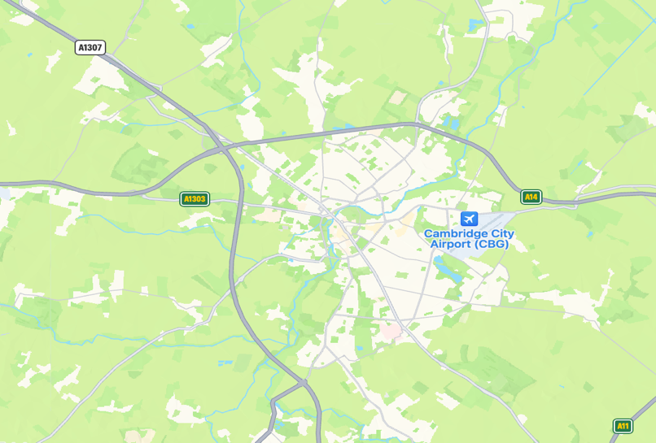
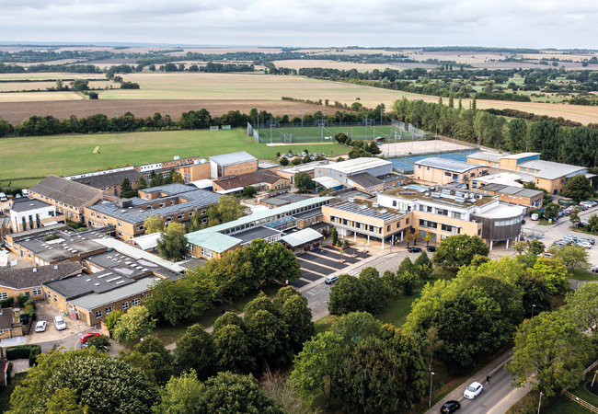

Comberton Village College
Cambridge
Comberton Village College

Slide 10
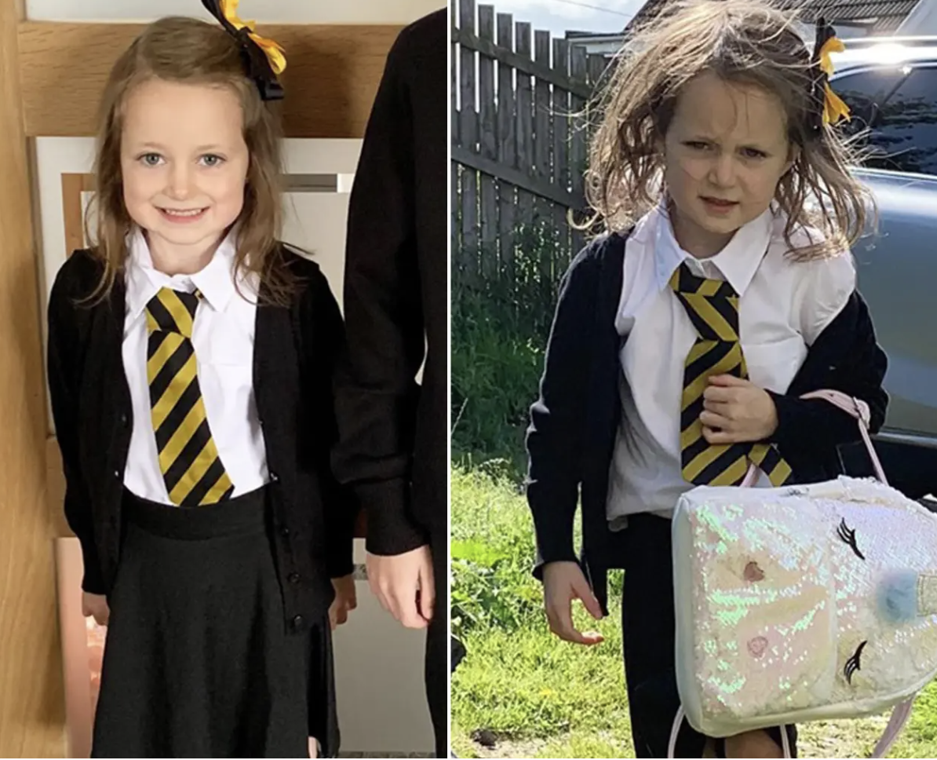
September in Schools – all change!
For some pupils it is the first week at a new school.
Comberton Village College is large by UK standards (1700 pupils), some of the pupils will have come from very small schools.
Children have very different holiday experiences:
  Some will be pleased to be back
  Some, not so much …
New courses, moving into ”exam years”.
Some teachers may be new too.
It’s the first week of school ...
… which can be hard.

Slide 11
Some Frameworks

Slide 12

Children’s Rights and Responsibilities
Rights-based approaches are usually based on the UN Convention on the Rights of the Child.
All children have the same rights including the right to a safe childhood and an education.
Comberton VC is a Rights-Respecting School.
Why This is Important!
As Teaching Assistants this will be a framework for organizing learning, resolving problems, and your relationships with the students.

Slide 13
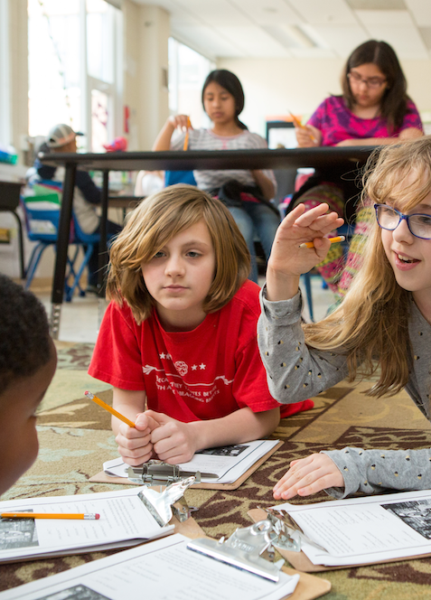
Competences in the Classroom
The idea of competences or life skills is addressed explicitly – and built into the teachers’ planning of learning. For example:
Group working, trying to develop teamwork skills.
Children reflecting and assessing their own skills and progress (‘learning to learn’).
Digital tools used but not clear whether these are developing ‘digital literacies’.
‘Problem-based’ learning is used in the school but needs to be planned carefully: what does ‘Challenge Learning’ or ‘Problem-based’ learning look like with young children? How is it different from play? Does this matter?
Why This is Important!
As Teaching Assistants you may be involved in supporting small groups, working on projects, supporting use of digital tools.

Slide 14
Classroom Talk – Oracy and Dialogue
One area that is currently of much interest is oracy and classroom dialogue.
What is Oracy?
  Learning to talk and express oneself effectively
  Learning through talk
  Learning about talk
  But children need support to develop oracy skills
Teachers were actively managing classroom dialogues, and modelling dialogue and active learning skills (with other adults, puppets, or selected children)
Effective classroom dialogue involving ‘building on’ ideas, respectful challenge and active participation by children leads to significant learning gains.
‘Building on’/ Elaborating
Student Participation
Challenging
Learning Gains
Why This is Important!
As Teaching Assistants working to develop spoken language, dialogue, and ensuring participation will be part of your role.
Howe, Hennessy et al. 2019

Slide 15
Teachers as Researchers

Slide 16
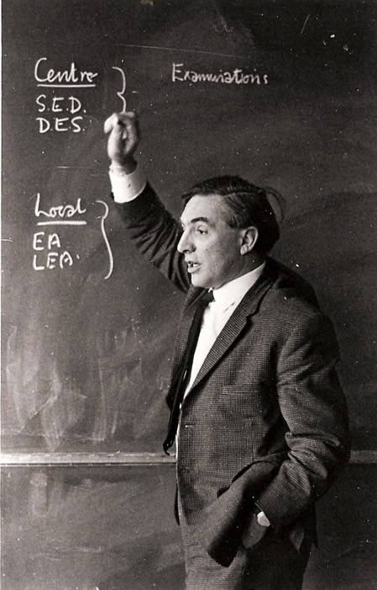
Researching “the World of the School”
“It is teachers who in the end will change the world of the school by understanding it.” (Stenhouse, 1981)
Large scale surveys or experiments (by government agencies or university researchers) provide particular, partial ‘lenses’ on education.
Teacher research captures the world of the individual school, the experience of the child, the ‘practice-knowledge’ of teachers and other educational workers.
It helps us to achieve “worthwhile educational change” (Elliott, 1991)
©CARE Archive, UEA

Slide 17
Why Teacher Research?
We don’t just want you to become great teachers …
We want you to become great teacher-researchers!
Why?
Because teacher involvement in systematic, collaborative, reflective research into their practice is one of the most effective types of teacher professional development.
It has positive impact on children’s learning outcomes
It has positive impact on professional identity as a teacher and school leader
It has positive impact at school level too - schools improve through teacher research

Slide 18
Research Focus and Research Questions
Teacher research asks questions like:
How can I introduce [a practice] to help children in [my setting] to learn [a key concept] more effectively and successfully than before?
How can [a practice] help children in [my setting] to develop [a key skill-set or habit-of-mind] more effectively and successfully than before?
How can I change [my practice or my setting] to improve a specific child’s or a group of children’s [ experience of school or social relations or learning ]?
The emphasis is on gaining insight and implementing change

Slide 19
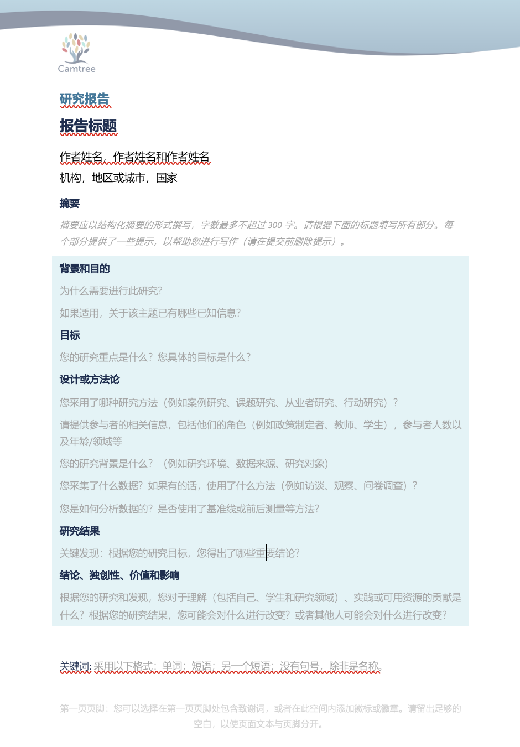
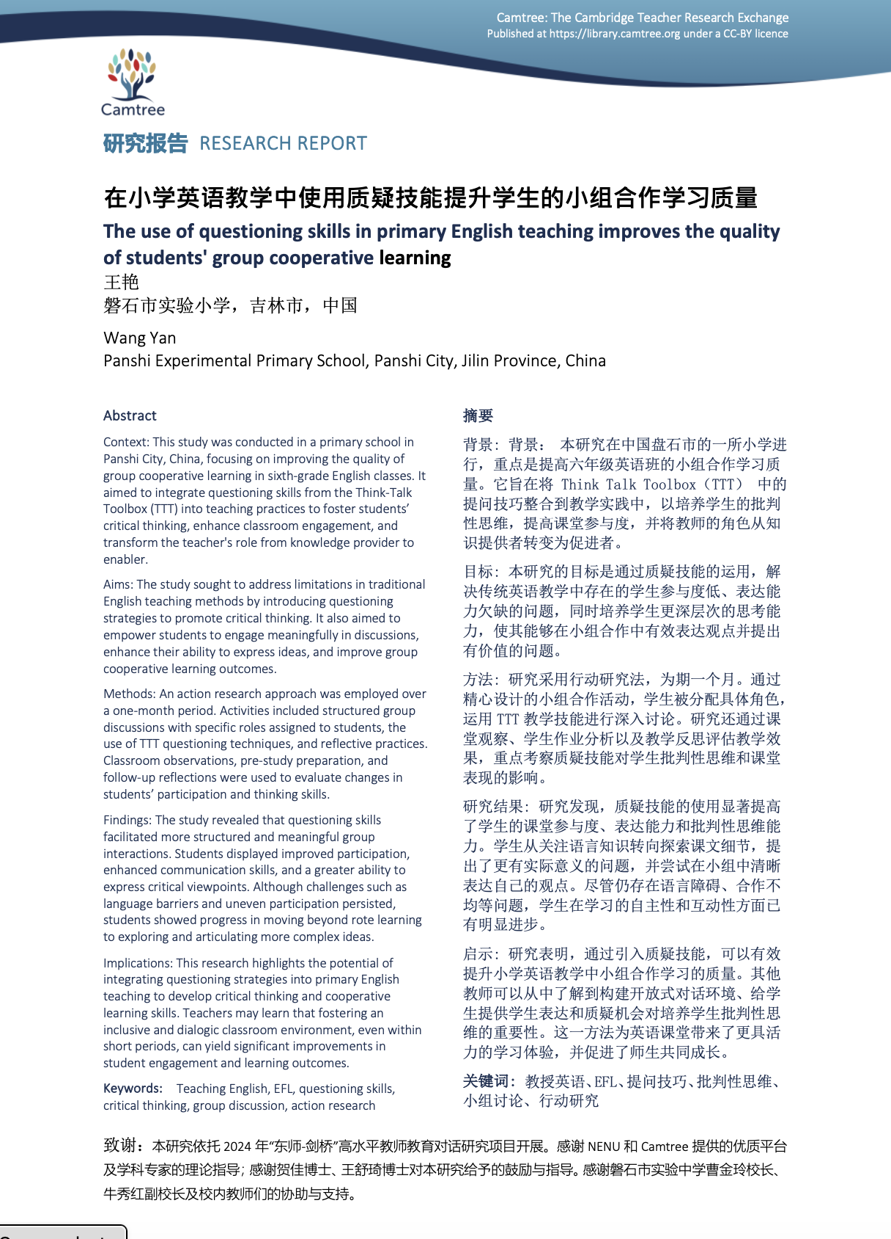
If you visit us …
  It is unlikely that you will be able to carry out any whole-class interventions or experiments.
  Surveys also may be difficult to administer – especially early in the school year.
Think about questions that can be addressed in your Teaching Assistant role.
We will provide inquiry ‘templates’ for you if you visit us.

Slide 20

“Making the strange familiar and the familiar strange”
Keep a reflective journal
Record things of interest, especially those that are ‘strange’
Be prepared to ask ‘silly questions’ – no-one will mind! You are ‘acceptable outsiders’.
  “Why do we do this?”
  “How did things get to be like this?”
  ”Have things always been like this?”
  ”Who does well from this, is anyone excluded, how do we change this?”
Start doing this now!
Gregory’s Girl, 1982
Child dressed as penguin 企鵝

Slide 21
Thank You! Questions?
https://www.camtree.org
https://library.camtree.org
camtree@hughes.cam.ac.uk
Weixin: Patrick_at_Camtree

