Slide 1
BNU-Cambridge Schools-Camtree Internship Project
BNU Internship Project
29 June 2025
Introduction and Orientation
Dr. Patrick Carmichael
Camtree: The Cambridge Teacher Research Exchange
Hughes Hall, University of Cambridge

Slide 2
Welcome to Hughes Hall

Slide 3
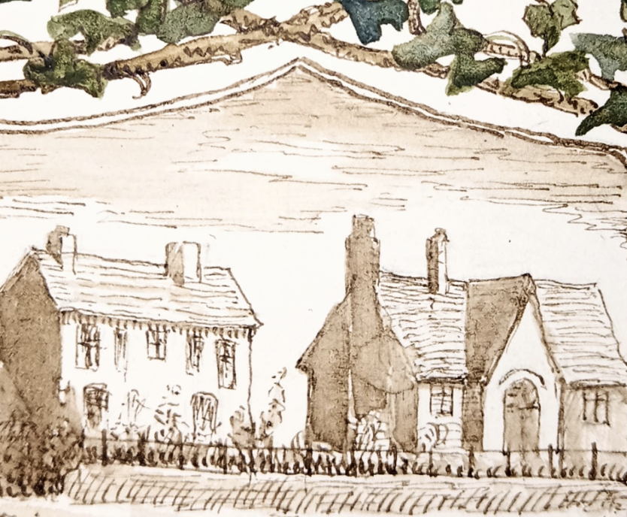
Hughes Hall and Education

Slide 4
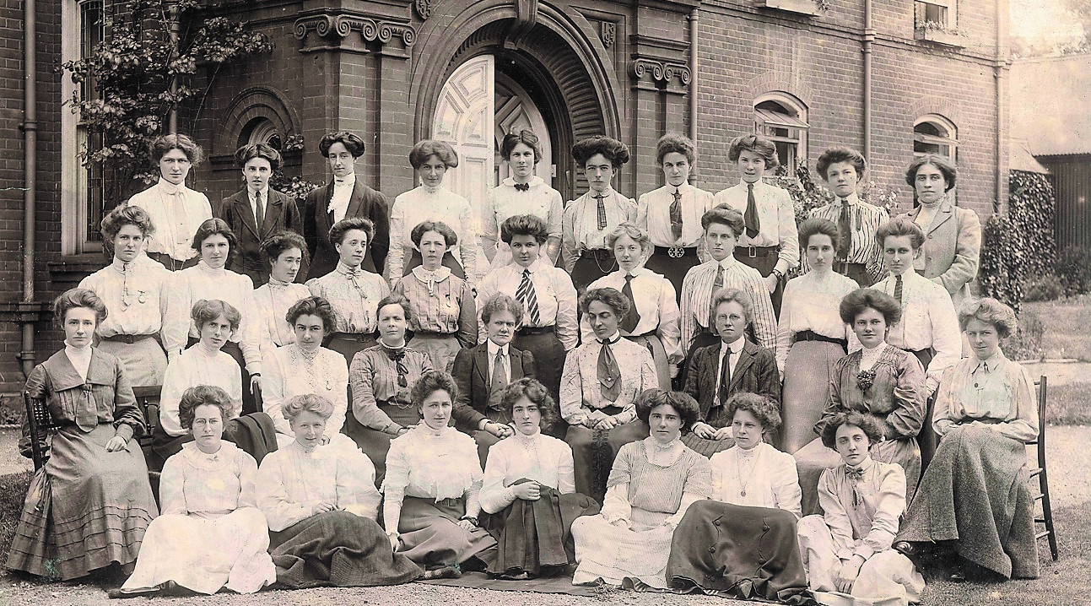
Hughes Hall and Education

Slide 5
Our Programme for the Week

Slide 6
An Overview of the Week and Programme
Monday: Comberton Village College
Tuesday: An introduction and focus on understanding UK Schools
Wednesday: Exploring Educational Dialogue
Thursday: Planning for an Inquiry into Educational Dialogue
Friday: Presentations and Next Steps
Three subsequent evening seminars
Be Prepared! We hope that you will carry out a small-scale piece of educational research during your time at Comberton Village College.

Slide 7
Now Over to You

Slide 8
Expectations of UK Schools before you arrived here
  What are you looking forward to?
  What are your concerns, anxieties, questions

Slide 9
Reactions to your visit to CVC
  Similarities and differences
  Staff training day - reactions?
  ‘Material culture’ of the School?

Slide 10
Some ‘lenses’ on UK Education

Slide 11

Children’s Rights and Responsibilities
Rights-based approaches are usually based on the UN Convention on the Rights of the Child.
All children have the same rights including the right to a safe childhood and an education.
Comberton VC is a Rights-Respecting School.
Why This is Important!
As Teaching Assistants this will be a framework for organizing learning, resolving problems, and your relationships with the students.

Slide 12
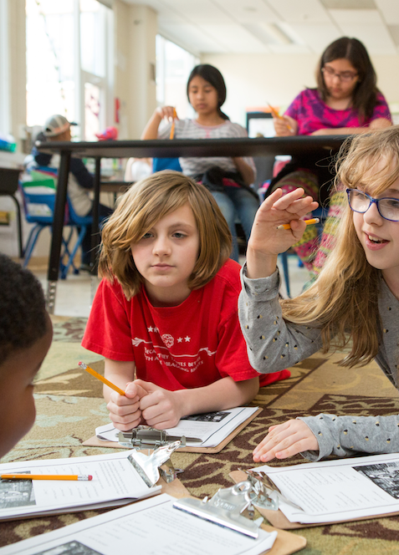
Competences in the Classroom
The idea of competences or life skills is increasingly being built into planning of learning. For example:
Group working, trying to develop teamwork skills.
Children reflecting and assessing their own skills and progress (‘learning to learn’).
Digital tools are used – in many classes they have replaced textbooks – at CVC all students have a tablet.
‘Problem-based’ learning is used in the school but needs to be planned carefully – look for examples of this – how/when/where?
Why This is Important!
As Teaching Assistants you may be involved in supporting small groups, working on projects, supporting use of digital tools.

Slide 13
Classroom Talk – Oracy and Dialogue
One area that is currently of much interest is oracy and classroom dialogue.
What is Oracy?
  Learning to talk and express oneself effectively
  Learning through talk
  Learning about talk
  But children need support to develop oracy skills
Effective classroom dialogue involving ‘building on’ ideas, respectful challenge and active participation by children leads to significant learning gains.
‘Building on’/ Elaborating
Student Participation
Challenging
Learning Gains
Why This is Important!
As Teaching Assistants working to develop spoken language, dialogue, and ensuring participation will be part of your role.
Howe, Hennessy et al. 2019

Slide 14
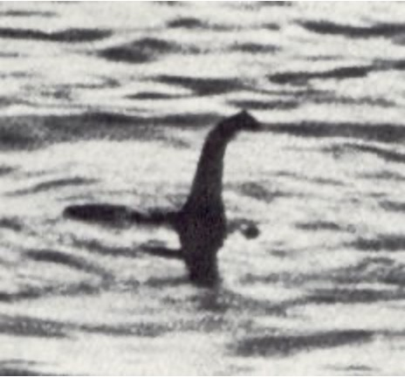
I don’t know much about this, but I think …
An interesting observation from the 2024 group of BNU students!
Learners are encouraged to express opinions, responses to text, empathy (‘what would it have been like?’) …
But on what basis?
And how to get from ‘I think ...’ to ‘we think …’
Now, I don't know anything about zoology, biology, geology, geography, marine biology, cryptozoology, evolutionary theory, evolutionary biology, meteorology, limnology, history, herpetology, palaeontology or archaeology … but I think ‘what if a dinosaur had got in the lake?’
Stewart Lee, about the Loch Ness Monster
Why This is Important!
As Teaching Assistants you will work to improve confidence and self-expression, but also promote critical thinking and collective learning.

Slide 15
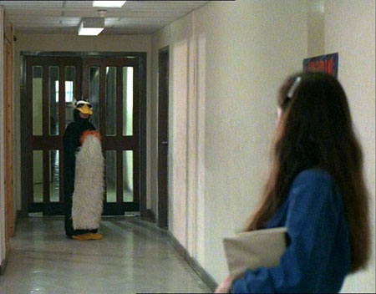
“Making the strange familiar and the familiar strange”
Keep a reflective journal
Record things of interest, especially those that are ‘strange’
Be prepared to ask ‘silly questions’ – no-one will mind! You are ‘acceptable outsiders’.
  “Why do we do this?”
  “How did things get to be like this?”
  ”Have things always been like this?”
  ”Who does well from this, is anyone excluded, how do we change this?”
Start doing this now!
Gregory’s Girl, 1982
Child dressed as penguin 企鵝

Slide 16
Finally
Take a few minutes to reflect …
Questions:
  About the UK in general?
  About education in the UK?
  About your experiences so far?

